Slide 1
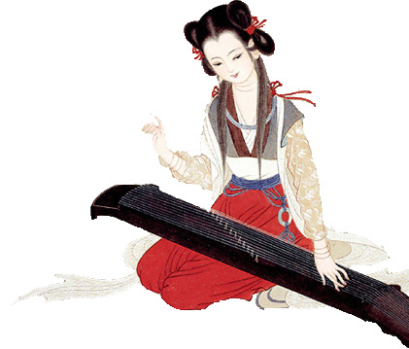
The Beauty and Diversity of Chinese Music
Houming Ge

Slide 2
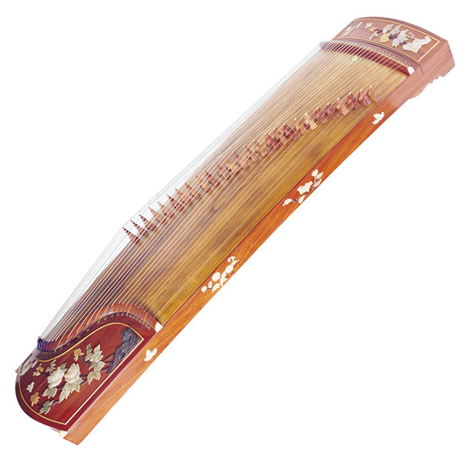
Introduction:
"Music is the art which is most nigh to tears and memories." - Oscar Wilde

Slide 3
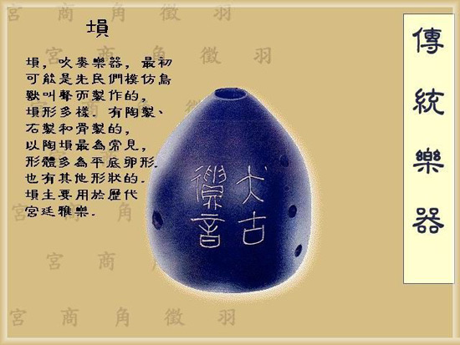

The Different Styles of Chinese Music

Slide 4
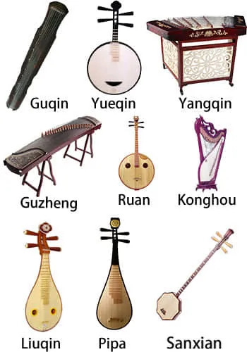
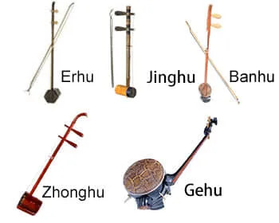
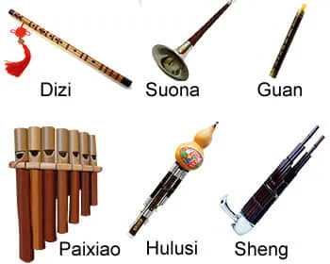
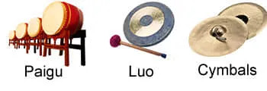
The Instruments Used in Chinese Music

Slide 5
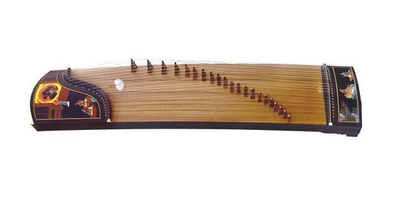
Guzheng

Slide 6
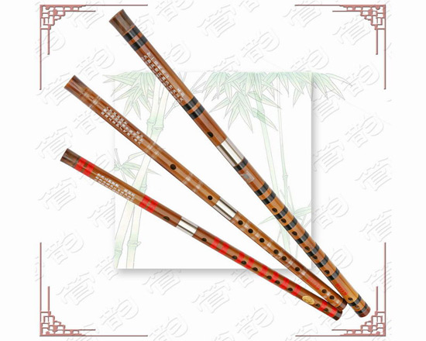
Dizi

Slide 7
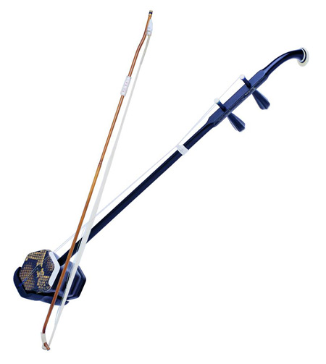
erhu

Slide 8
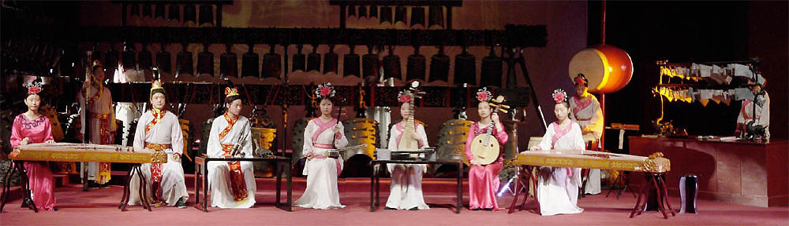
The Impact of Chinese Music on Culture and Society

Slide 9
Thank you:
http://www.chinafacttours.com/photo/music/chinese-music/index-19.html
https://miloshluczynski.com/wp-content/uploads/2018/11/ART-SNAP-02s.jpg
https://www.chinaeducationaltours.com/guide/culture-chinese-music.htm
https://en.wikipedia.org/wiki/Music_of_China#/media/File:ConcertGroupPano.jpg

